Slide 1
Introduction to Statistical Methods
ISM Team

Slide 2
Session-5
Random Variables
21st & 22nd December 2024

Slide 3

IMP Note to Self

Slide 4
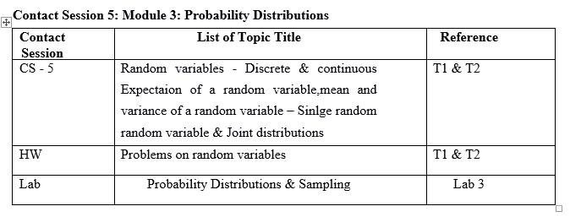
4

Slide 5
Agenda
Random variables
Discrete & continuous random variable,
Probability Distribution Function
Mean(Expectation) and variance of a random variable
Joint distributions
5

Slide 6
Random Variables
A random variable is a variable that assumes numerical values associated with the random outcome of an experiment, where one (and only one) numerical value is assigned to each sample point.
In mathematical language, a random variable is a function whose domain is the sample space and whose range is the set of real numbers.
6

Slide 7
Random Variables
A random variable can be classified as being either discrete or continuous depending on the numerical values it assumes:
A discrete random variable may assume either finite or countably infinite number of values
A continuous random variable may assume any numerical value in an interval or collection of intervals.
Continuous random variables are generated in experiments where things are “measured’ as opposed to “counted”.
Experimental outcomes based on measurement of time, distance, weight, volume etc. generate continuous RV.
7

Slide 8
Types of Random Variables
A discrete random variable can assume a countable number of values.
Number of steps to the top of the Eiffel Tower
Number of Heads obtain after tossing two coins simultaneously
A continuous random variable can assume any value along a given interval of a number line.
The time a tourist stays at the top once s/he gets there.
The height of a person can take any value within a certain range (e.g., 150 cm to 200 cm),

Slide 9


Examples of Random Variables
Discrete random variables
Number of sales
Number of calls
Shares of stock
People in line
Mistakes per page
Continuous random variables
Length
Depth
Volume
Time
Weight
9

Slide 10
Identify which of the following variables are discrete and which are continuous:
The number of books in a library.
The weight of a watermelon in kilograms.
The amount of rainfall in a day (in millimeters).
The number of passengers on a bus.
The temperature of a cup of coffee (in °C).
The number of goals scored in a football match.
The length of a bridge (in meters).
The number of steps you take in a day.
The time it takes to bake a cake (in minutes).
10

Slide 11
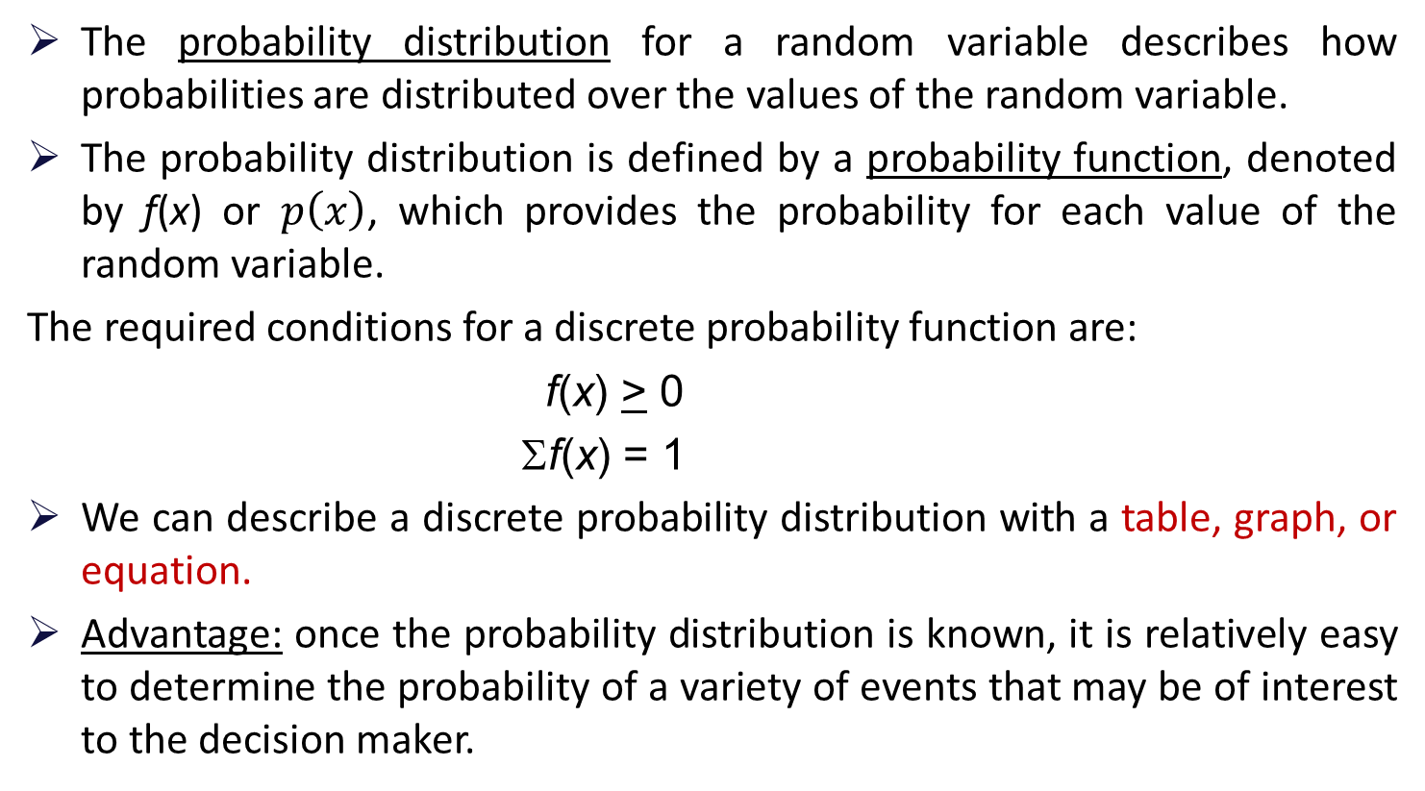
Discrete Probability Distributions
The probability distribution for a random variable describes how probabilities are distributed over the values of the random variable.
The probability distribution is defined by a probability function, denoted by f(x) or $p\left(x\right)$, which provides the probability for each value of the random variable.
The required conditions for a discrete probability function are:
f(x) > 0
Σf(x) = 1
We can describe a discrete probability distribution with a table, graph, or equation.
Advantage: once the probability distribution is known, it is relatively easy to determine the probability of a variety of events that may be of interest to the decision maker.
11

Slide 12
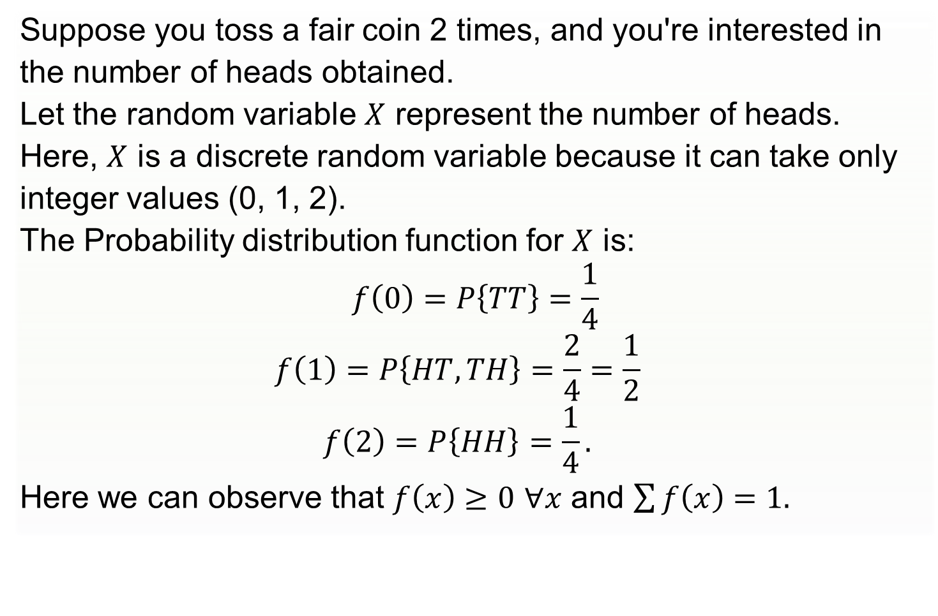
Probability Distributions for Discrete Random Variables
Suppose you toss a fair coin 2 times, and you're interested in
the number of heads obtained.
Let the random variable $X$ represent the number of heads.
Here, $X$ is a discrete random variable because it can take only
integer values (0, 1, 2).
The Probability distribution function for $X$ is:
$$f\left(0\right)=P\left\{TT\right\}=\frac{1}{4}$$
$$f\left(1\right)=P\left\{HT,TH\right\}=\frac{2}{4}=\frac{1}{2}$$
$$f\left(2\right)=P\left\{HH\right\}=\frac{1}{4}.$$
Here we can observe that $f\left(x\right)≥0$ $∀x$ and $\sum{f\left(x\right)=1.}$
12

Slide 13
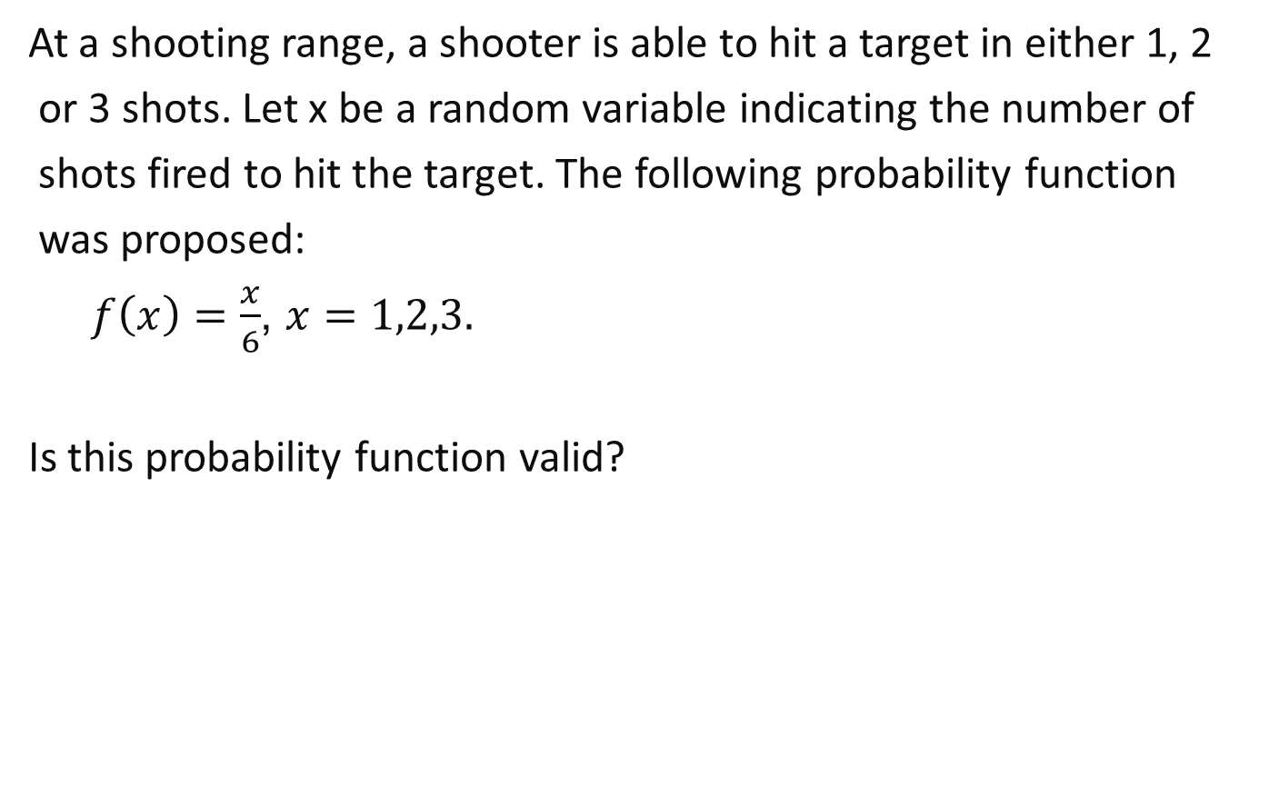
Example
At a shooting range, a shooter is able to hit a target in either 1, 2
or 3 shots. Let x be a random variable indicating the number of
shots fired to hit the target. The following probability function
was proposed:
$f\left(x\right)=\frac{x}{6}$, $x=1,2,3.$
Is this probability function valid?
13

Slide 14
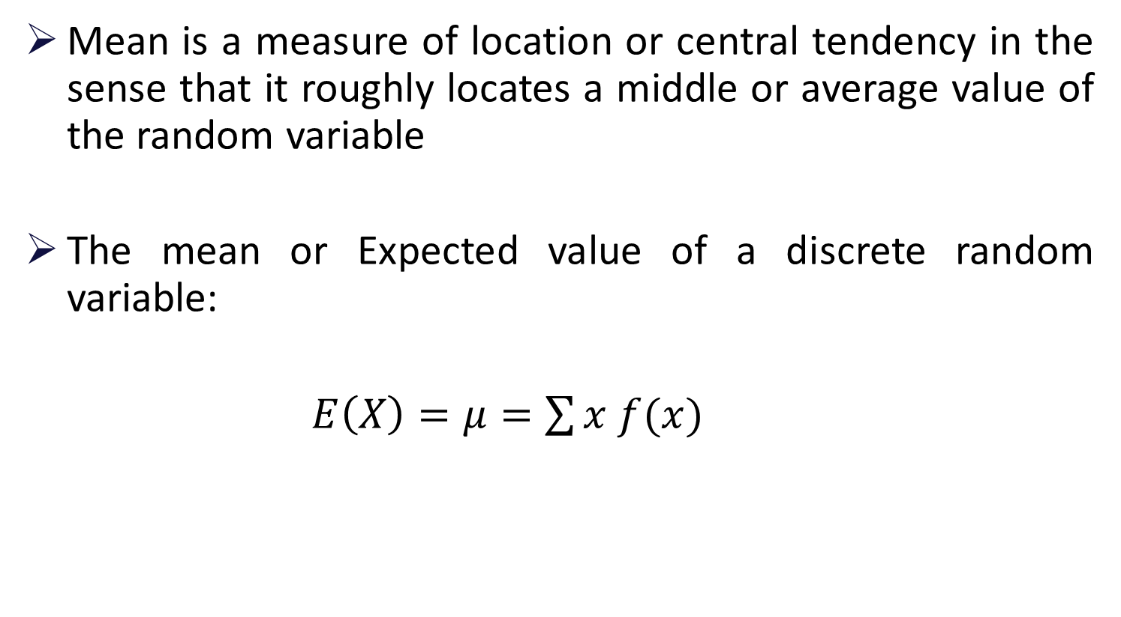
Expected Value
Mean is a measure of location or central tendency in the sense that it roughly locates a middle or average value of the random variable
The mean or Expected value of a discrete random variable:
$E\left(X\right)=μ=\sum{x f(x)}$
14

Slide 15
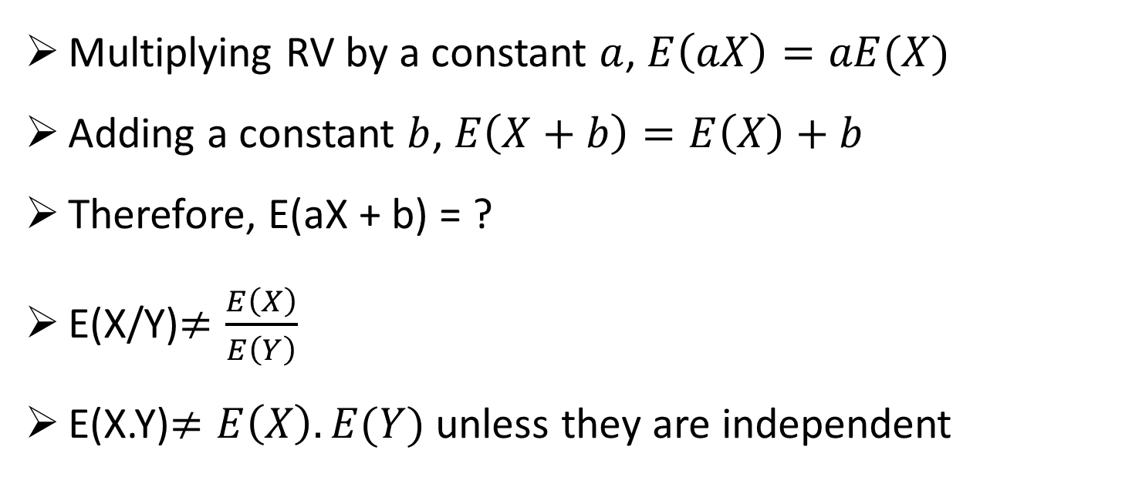
Rules of Expected Value
Multiplying RV by a constant $a$, $E\left(aX\right)=aE(X)$
Adding a constant $b$, $E\left(X+b\right)=E\left(X\right)+b$
Therefore, E(aX + b) = ?
E(X/Y)$≠\frac{E\left(X\right)}{E\left(Y\right)}$
E(X.Y)$≠E\left(X\right).E(Y)$ unless they are independent
15

Slide 16
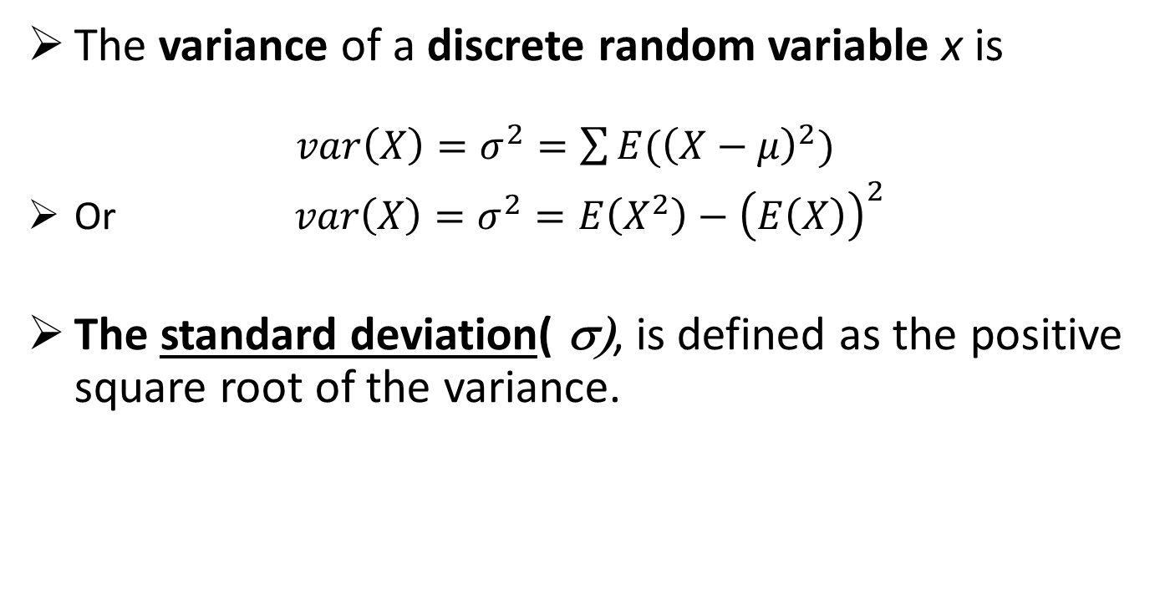
Variability of Discrete Random Variables
The variance of a discrete random variable x is
$var\left(X\right)=σ^{2}=\sum{E({\left(X−μ\right)}^{2})}$
Or $var\left(X\right)=σ^{2}=E\left(X^{2}\right)−{\left(E\left(X\right)\right)}^{2}$
The standard deviation( σ), is defined as the positive square root of the variance.
16

Slide 17
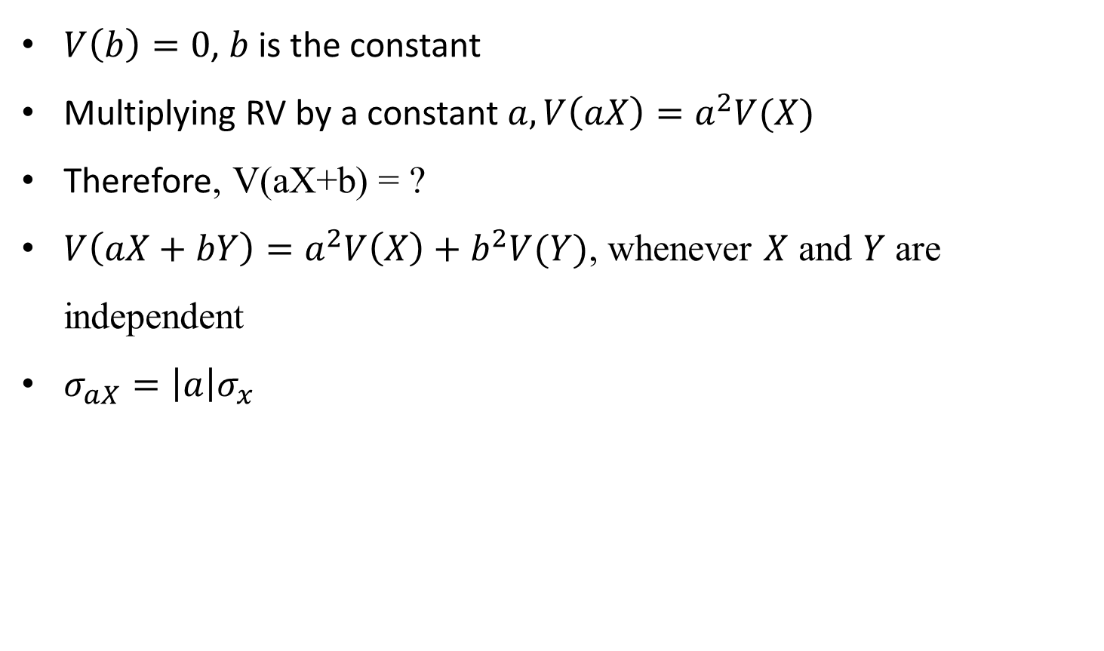
Rules of variability
$V\left(b\right)=0$, $b$ is the constant
Multiplying RV by a constant $a, V\left(aX\right)=a^{2}V(X)$
Therefore, V(aX+b) = ?
$V\left(aX+bY\right)=a^{2}V\left(X\right)+b^{2}V(Y)$, whenever $X$ and $Y$ are independent
$σ_{aX}=\left|a\right|σ_{x}$
17

Slide 18
Example:
A game is played by two person A and B as follows:
“A throws two dice. If the sum is 7 he wins $3 from B. If the sum is 8 he loses $2
and if sum is 3 he loses $4, otherwise no money changes hand. Is this a fair game?”

Slide 19
Example:
Discrete random variable with a finite number of values
Let x = number of TV sets sold at the store in one day
where x can take on 5 values (0, 1, 2, 3, 4)
Discrete random variable with an infinite sequence of values
Let x = number of customers arriving in one day
where x can take on the values 0, 1, 2, . . .
We can count the customers arriving, but there is no finite upper limit on the number that might arrive.
19

Slide 20
Example : KPN Appliances
Using past data on TV sales (below left), a tabular representation of the probability distribution for TV sales (below right) was developed.
20

Slide 21
Example:
Graphical Representation of the Probability Distribution
.50
.40
Probability
.30
.20
.10
0 1 2 3 4
Values of Random Variable x (TV sales)
21

Slide 22
Example:
Expected Value of a Discrete Random Variable
The expected number of TV sets sold in a day is 1.2
22

Slide 23
Example: KPN Appliances
Variance and Standard Deviation of a Discrete Random Variable
x x - μ (x - μ)² f(x) (x - μ)²f(x)
0 -1.2 1.44 .40 .576
1 -0.2 0.04 .25 .010
2 0.8 0.64 .20 .128
3 1.8 3.24 .05 .162
4 2.8 7.84 .10 .784
1.660 = σ ²
The variance of daily sales is 1.66 TV sets squared.
The standard deviation of sales is 1.2884 TV sets.
23

Slide 24
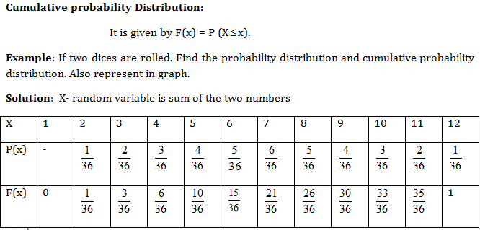
Cumulative Distribution for Discrete Data
24

Slide 25
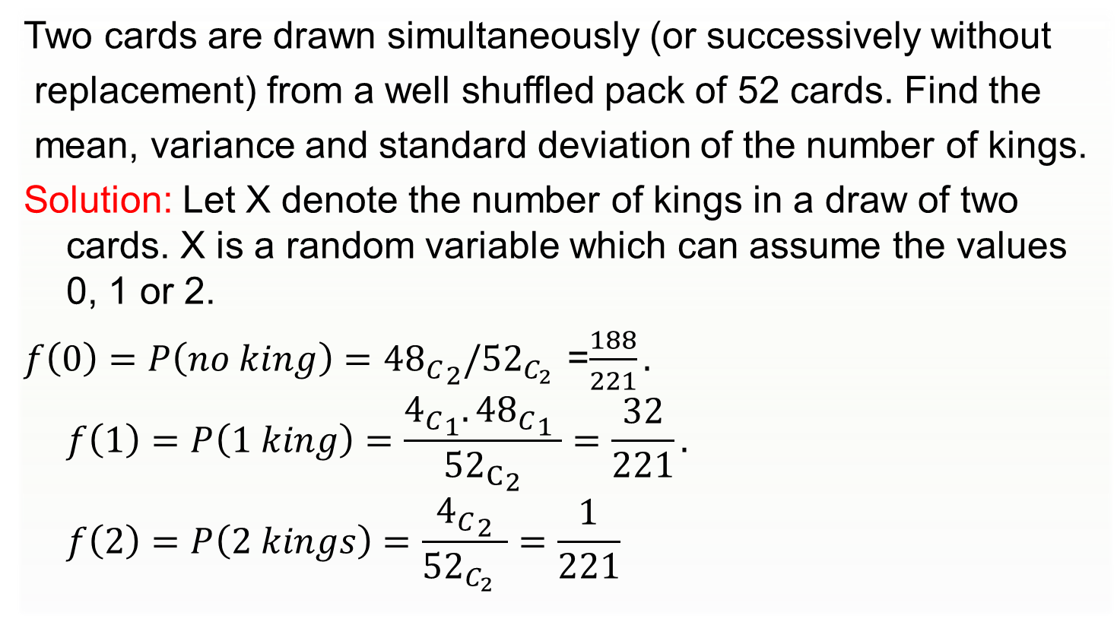
Example: 1
Two cards are drawn simultaneously (or successively without
replacement) from a well shuffled pack of 52 cards. Find the
mean, variance and standard deviation of the number of kings.
Solution: Let X denote the number of kings in a draw of two cards. X is a random variable which can assume the values 0, 1 or 2.
$f\left(0\right)=P\left(no king\right)={{48}_{C}}_{2}/{52}_{C_{2} }$=$\frac{188}{221}.$
$$f\left(1\right)=P\left(1 king\right)=\frac{{4_{C}}_{1}.{{48}_{C}}_{1} }{{{52}_{C}}_{2}}=\frac{32}{221}.$$
$$f\left(2\right)=P\left(2 kings\right)=\frac{{4_{C}}_{2}}{{52}_{C_{2} }}=\frac{1}{221}$$
25

Slide 26
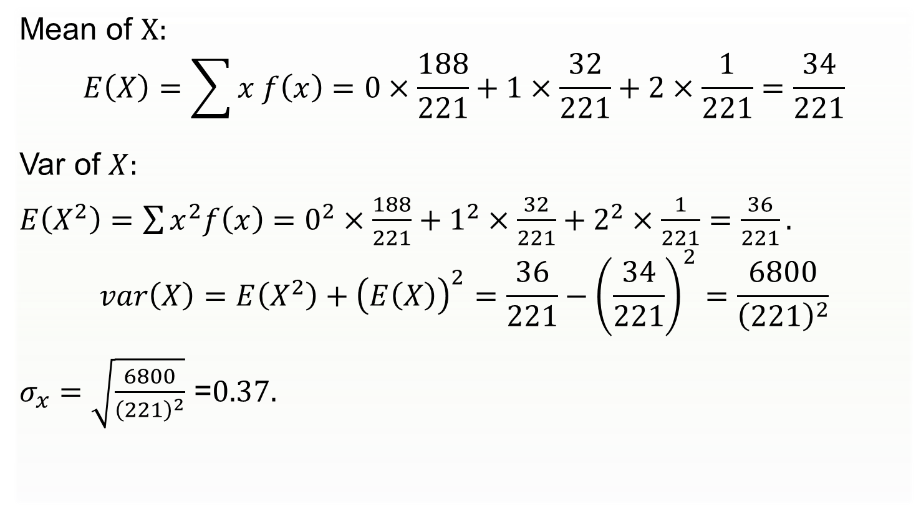
Solution:
Mean of $X:$
$$E\left(X\right)=\sum{x f\left(x\right)=0×\frac{188}{221}+1×\frac{32}{221}+2×\frac{1}{221}=\frac{34}{221}}$$
Var of $X:$
$E\left(X^{2}\right)=\sum{x^{2}f\left(x\right)=0^{2}×\frac{188}{221}+1^{2}×\frac{32}{221}+2^{2}×\frac{1}{221}}$ $=\frac{36}{221}.$
$$var\left(X\right)=E\left(X^{2}\right)+{\left(E\left(X\right)\right)}^{2}=\frac{36}{221}−{\left(\frac{34}{221}\right)}^{2}=\frac{6800}{{\left(221\right)}^{2}}$$
$σ_{x}=\sqrt{\frac{6800}{{\left(221\right)}^{2}}}$ =$0.37.$
26

Slide 27
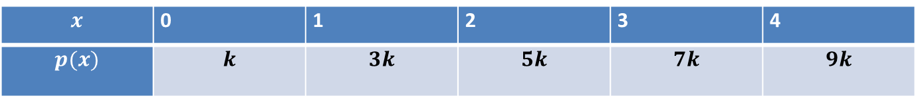
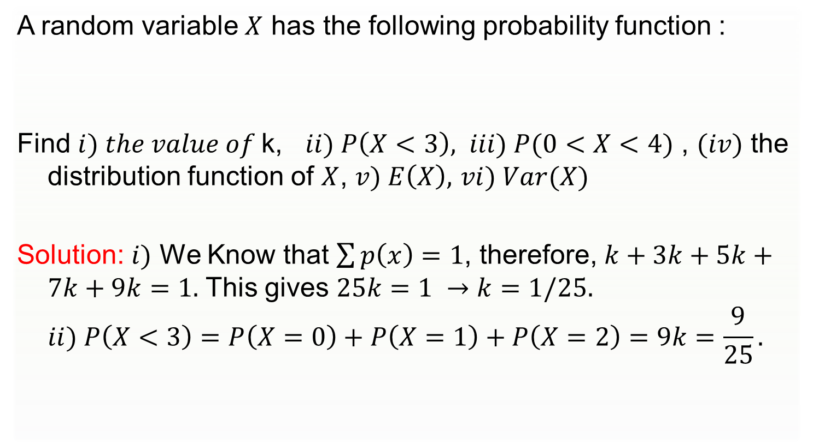
Example: 2
A random variable $X$ has the following probability function :
Find $i) the value of$k, $ii) P\left(X<3\right),$ $iii) P(0<X<4)$ , $(iv)$ the distribution function of $X$, $v) E\left(X\right),$ $vi) Var(X)$
Solution: $i)$ We Know that $\sum{p\left(x\right)=1}$, therefore, $k+3k+5k+7k+9k=1.$ This gives $25k=1 →k=1/25.$
$$ii) P\left(X<3\right)=P\left(X=0\right)+P\left(X=1\right)+P\left(X=2\right)=9k=\frac{9}{25}.$$
$$x$$ | 0 | 1 | 2 | 3 | 4
$$p(x)$$ | $$k$$ | $$3k$$ | $$5k$$ | $$7k$$ | $$9k$$
27

Slide 28
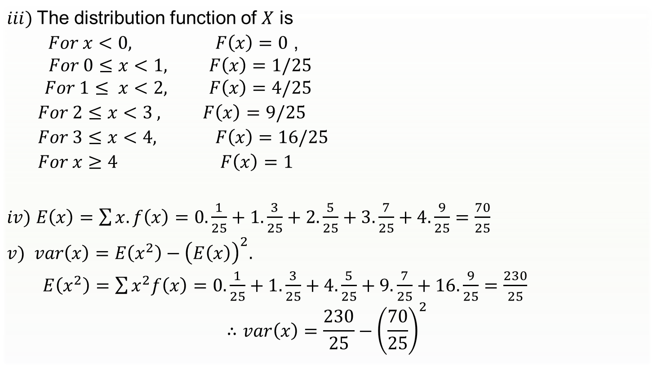
Solution
$iii)$The distribution function of $X$ is
$For x<0, F\left(x\right)=0$ ,
$$For 0≤x<1, F\left(x\right)=1/25$$
$$For 1≤ x<2, F\left(x\right)=4/25$$
$For 2≤x<3 , F\left(x\right)=9/25$
$For 3≤x<4, F\left(x\right)=16/25$
$For x≥4 F\left(x\right)=1$
$iv)$ $E\left(x\right)=\sum{x.f\left(x\right)=0. \frac{1}{25}+1. \frac{3}{25}+2. \frac{5}{25}}+3.\frac{7}{25}+4.\frac{9}{25}=\frac{70}{25}$
$v)$ $var\left(x\right)=E\left(x^{2}\right)−{\left(E\left(x\right)\right)}^{2}.$
$E\left(x^{2}\right)=\sum{x^{2}f\left(x\right)=0.\frac{1}{25}}+1.\frac{3}{25}+4.\frac{5}{25}+9.\frac{7}{25}+16.\frac{9}{25}=\frac{230}{25}$
$$∴var\left(x\right)=\frac{230}{25}−{\left(\frac{70}{25}\right)}^{2}$$
28

Slide 29
Discrete Uniform Probability Distribution
The discrete uniform probability distribution is the simplest example of a discrete probability distribution given by a formula.
The discrete uniform probability function is
f(x) = 1/n
where:
n = the number of values the random variable may assume
Note that the values of the random variable are equally likely.
29

Slide 30
Classification of Random Variables
Random variable
Discrete
Probability mass function(pmf)
f(x)
Cumulative distribution function
F(x)
Continuous
Probability Density function(pdf)
f(x)
Cumulative distribution function
F(x)
30

Slide 31
Continuous Probability Distributions
A continuous random variable can assume any value in an interval on the real line or in a collection of intervals.
It is not possible to talk about the probability of the random variable assuming a particular value.
Instead, we talk about the probability of the random variable assuming a value within a given interval.
The probability of the random variable assuming a value within some given interval from x₁ to x₂ is defined to be the area under the graph of the probability density function between x₁ and x₂.
31

Slide 32
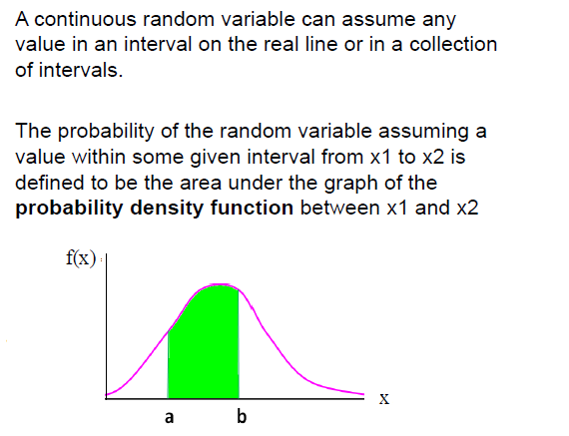
Continuous Random Variables
Example:
Height of students in a class
Amount of ice tea in a glass
Change in temperature throughout a day
Price of a car in next year

Slide 33
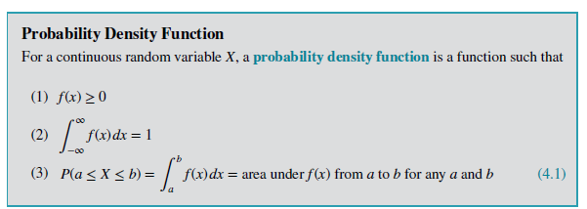
Continuous Random Variables

Slide 34
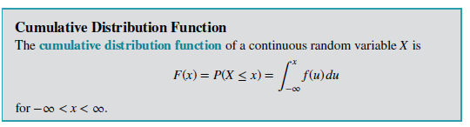
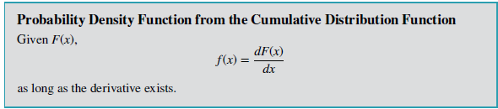
Continuous Random Variables

Slide 35
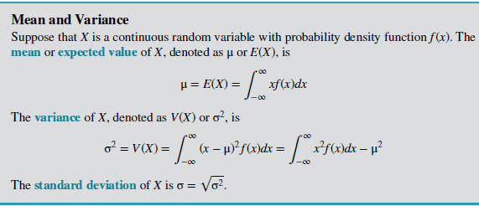
Continuous Random Variables

Slide 36
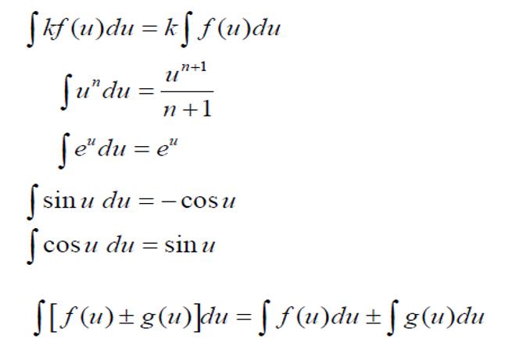
Recall: Integration Formulas

Slide 37
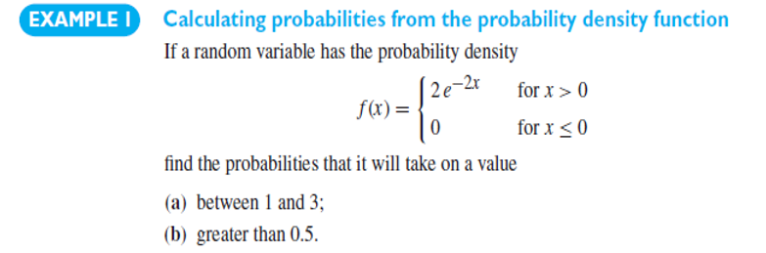
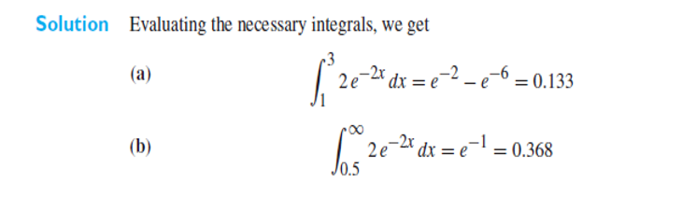
Continuous Random Variables

Slide 38
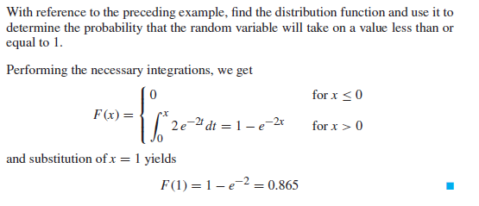

Slide 39
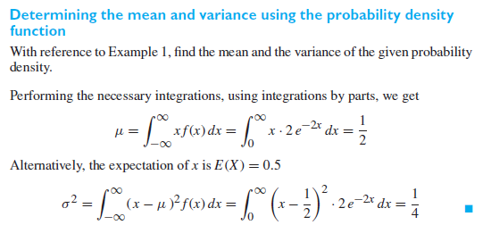

Slide 40
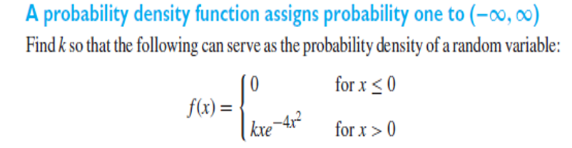
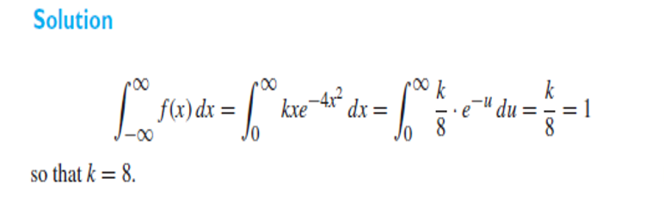

Slide 41
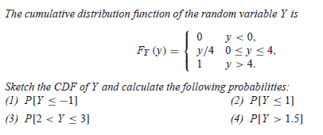
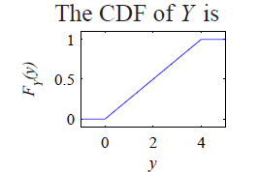
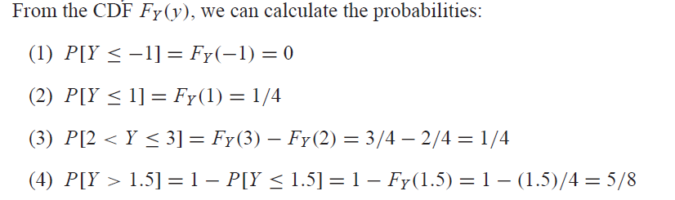
Cumulative Distribution for continuous Data

Slide 42
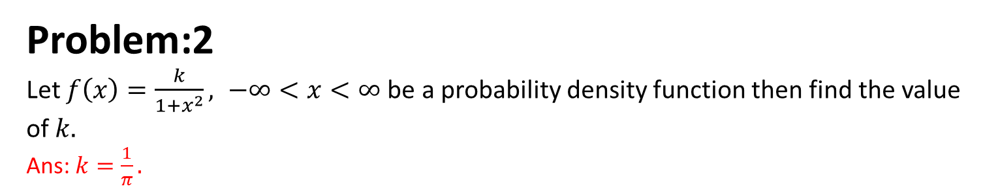
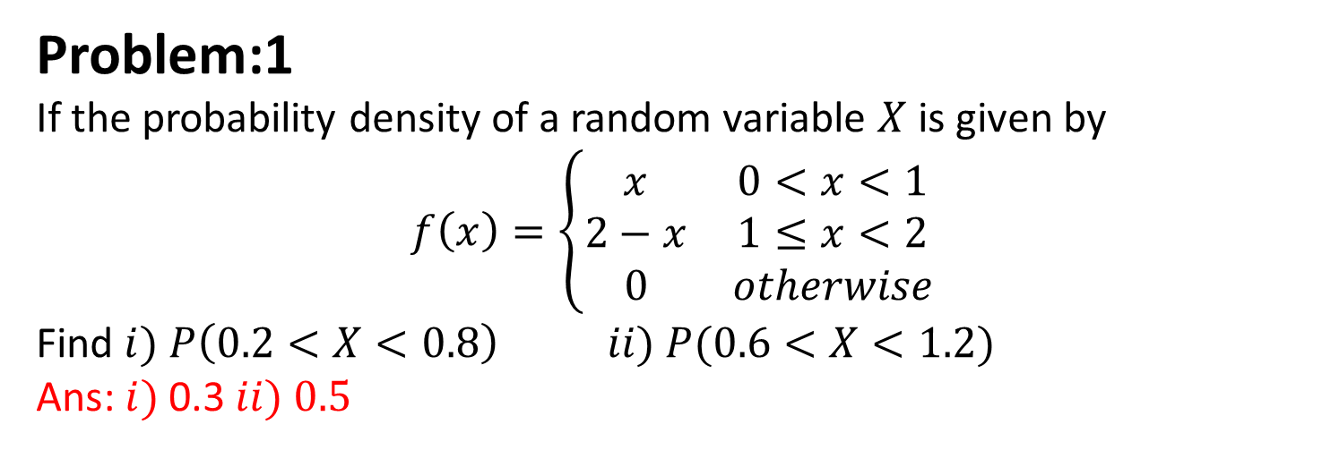
Practice Problems-set 1
Problem:1
If the probability density of a random variable $X$ is given by
$$f\left(x\right)=\left\{\begin{matrix}x & 0<x<1 \\ 2−x & 1≤x<2 \\ 0 & otherwise\end{matrix}\right.$$
Find $i) P\left(0.2<X<0.8\right) ii) P(0.6<X<1.2)$
Ans: $i)$0.3 $ii) 0.5$
Problem:2
Let $f\left(x\right)=\frac{k}{1+x^{2}}, −∞<x<∞$be a probability density function then find the value of $k.$
Ans: $k=\frac{1}{π}.$

Slide 43
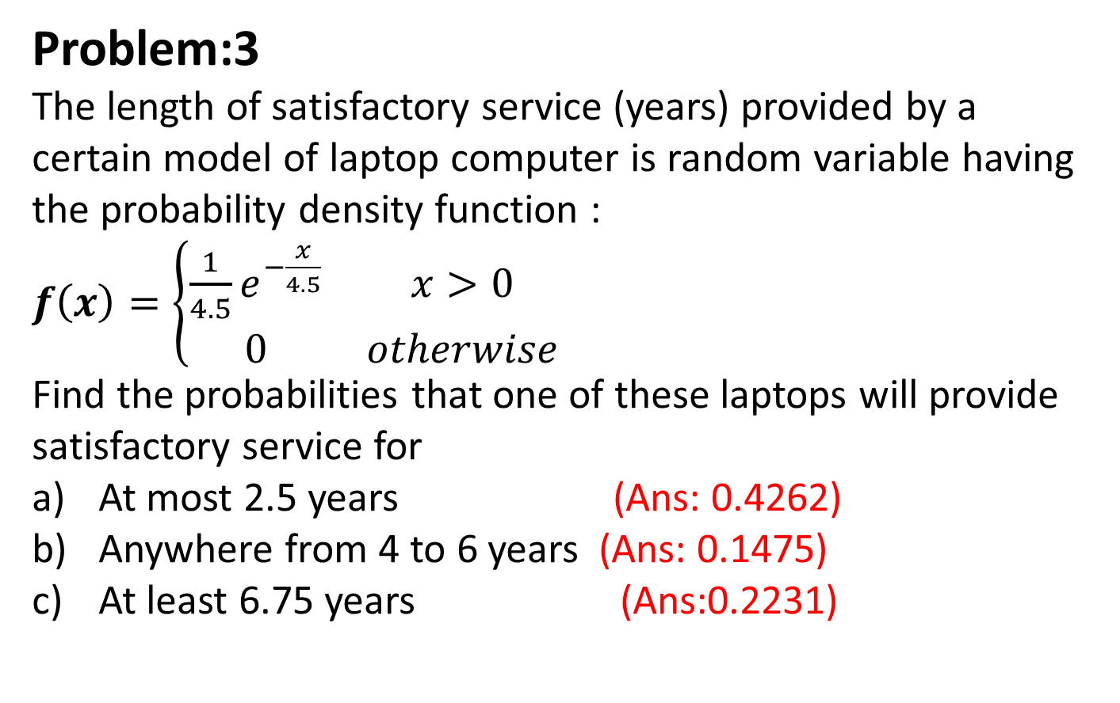
Problem:3
The length of satisfactory service (years) provided by a certain model of laptop computer is random variable having the probability density function :
$f\left(x\right)=\left\{\begin{matrix}\frac{1}{4.5}e^{−\frac{x}{4.5}} & x>0 \\ 0 & otherwise\end{matrix}\right.$
Find the probabilities that one of these laptops will provide satisfactory service for
At most 2.5 years (Ans: 0.4262)
Anywhere from 4 to 6 years (Ans: 0.1475)
At least 6.75 years (Ans:0.2231)

Slide 44
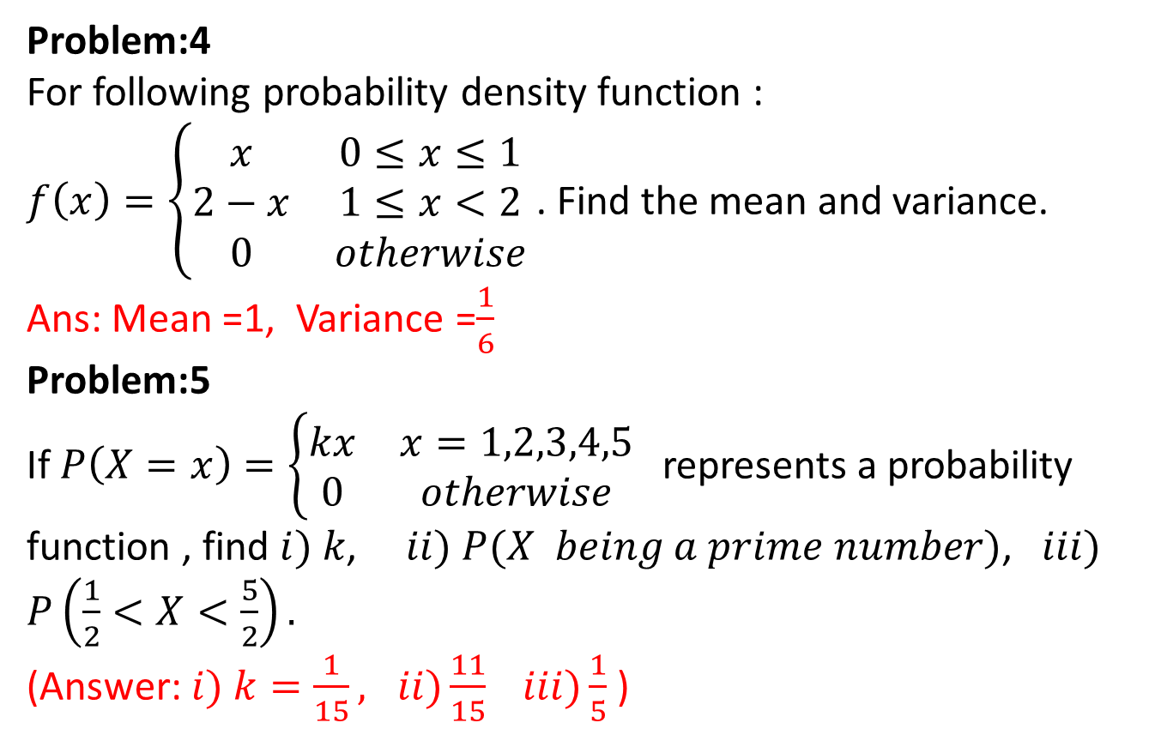
Problem:4
For following probability density function :
$f\left(x\right)=\left\{\begin{matrix}x & 0≤x≤1 \\ 2−x & 1≤x<2 \\ 0 & otherwise\end{matrix}\right.$ . Find the mean and variance.
Ans: Mean =1, Variance =$\frac{1}{6}$
Problem:5
If $P\left(X=x\right)=\left\{\begin{matrix}kx & x=1,2,3,4,5 \\ 0 & otherwise\end{matrix}\right.$ represents a probability function , find $i) k$, $ii) P(X being a prime number)$, $iii)$ $P\left(\frac{1}{2}<X<\frac{5}{2}\right).$
(Answer: $i) k=\frac{1}{15}, ii)\frac{11}{15} iii)\frac{1}{5}$ )

Slide 45
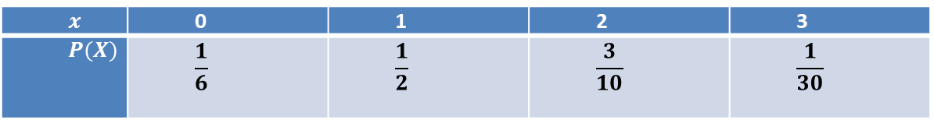
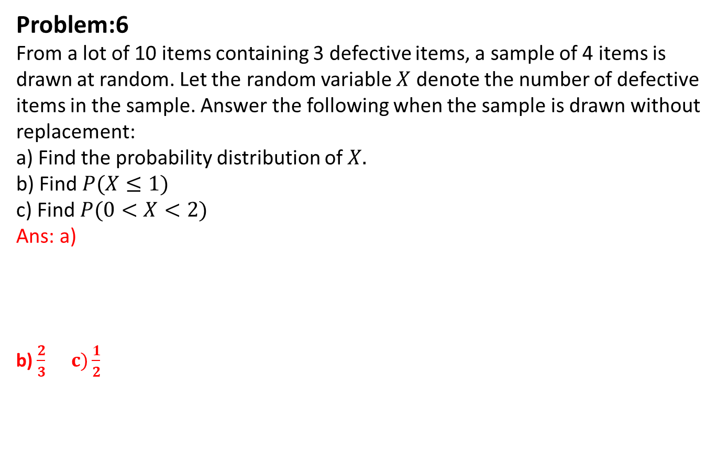
Problem:6
From a lot of 10 items containing 3 defective items, a sample of 4 items is drawn at random. Let the random variable $X$ denote the number of defective items in the sample. Answer the following when the sample is drawn without replacement:
a) Find the probability distribution of $X.$
b) Find $P(X≤1)$
c) Find $P(0<X<2)$
Ans: a)
b) $\frac{2}{3} c)\frac{1}{2}$
$$x$$ | 0 | 1 | 2 | 3
$$P(X)$$ | $$\frac{1}{6}$$ | $$\frac{1}{2}$$ | $$\frac{3}{10}$$ | $$\frac{1}{30}$$

Slide 46
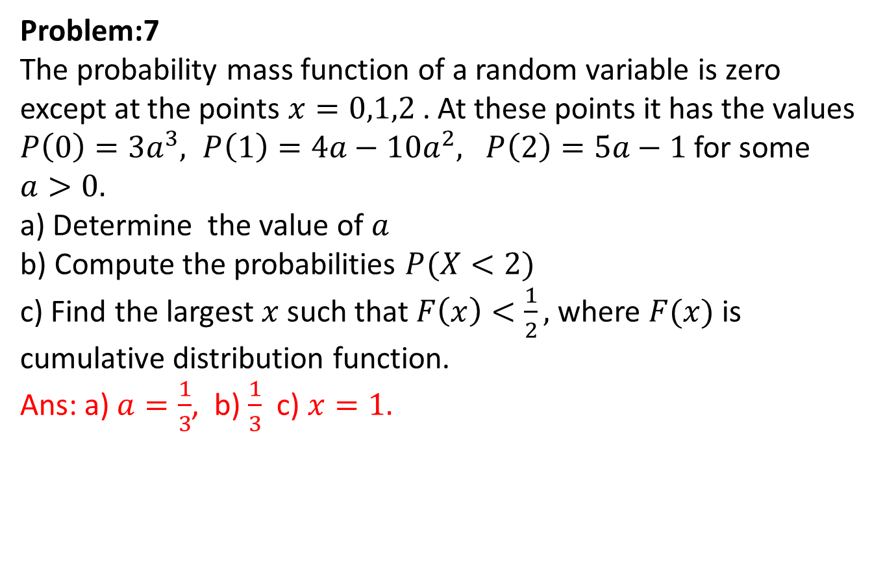
Problem:7
The probability mass function of a random variable is zero except at the points $x=0,1,2$ . At these points it has the values $P\left(0\right)=3a^{3}, P\left(1\right)=4a−10a^{2}, P\left(2\right)=5a−1$ for some $a>0.$
a) Determine the value of $a$
b) Compute the probabilities $P(X<2)$
c) Find the largest $x$ such that $F\left(x\right)<\frac{1}{2},$ where $F(x)$ is cumulative distribution function.
Ans: a) $a=\frac{1}{3}$, b) $\frac{1}{3}$ c) $x=1.$

Slide 47
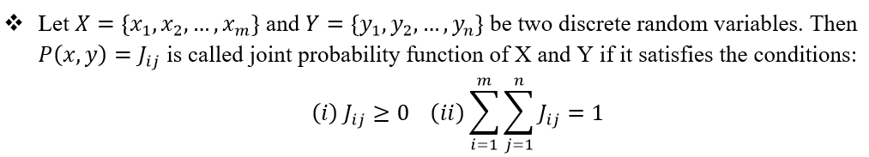
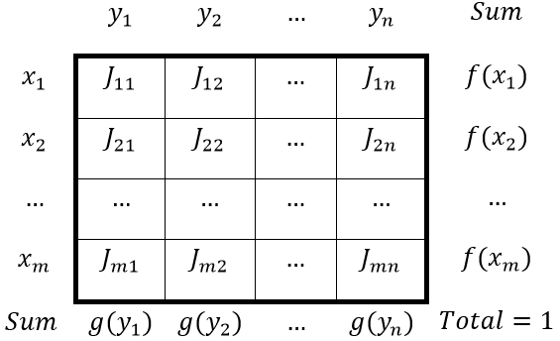
Joint Probability Distribution Function

Slide 48
If X and Y are discrete random variables, the joint probability distribution of X and Y is a description of the set of points (x,y) in the range of (X,Y) along with the probability of each point.
The joint probability distribution of two discrete random variables is sometimes referred to as the bivariate probability distribution or bivariate distribution.
Thus we can describe the joint probability distribution of two discrete random variables is through a joint probability mass function
f(x,y)=P(X=x,Y=y)
48

Slide 49
We often want to determine the joint probability of two variables, such as X and Y. Suppose we are able to determine the following information for education (X) and age (Y) for all Indian citizens based on the census.
Age (Y): Education (X) | Age : 25-35 30 | Age: 35-55 45 | Age: 55-85 70
None 0 | .01 | .02 | .05
Primary 1 | .03 | .06 | .10
Secondary 2 | .18 | .21 | .15
College 3 | .07 | .08 | .04
49

Slide 50
Each cell is the relative frequency (f/N).
We can define the joint probability distribution as:
p(x, y)= Pr(X = x and Y = y)
Example: what is the probability
of getting a 30 year old college
graduate?
p(x,y) = Pr(X=3 and Y=30) = .07
We can see that: p(x) = Σ_{y} p(x,y)
p(x=1) = .03 + .06 + .10 = .19
Age (Y): Education (X) | Age : 25-35 30 | Age: 35-55 45 | Age: 55-85 70
None 0 | .01 | .02 | .05
Primary 1 | .03 | .06 | .10
Secondary 2 | .18 | .21 | .15
College 3 | .07 | .08 | .04
50

Slide 51
Marginal Probability
We call this the marginal probability because it is calculated by summing across rows or columns and is thus reported in the margins of the table.
We can calculate this for our entire table.
Age (Y): Education (X) | 30 | 45 | 70 | p(x)
None: 0 | .01 | .02 | .05 | .08
Primary: 1 | .03 | .06 | .10 | .19
Secondary: 2 | .18 | .21 | .15 | .54
College: 3 | .07 | .08 | .04 | .19
p(y) | .29 | .37 | .34 | 1
51

Slide 53
Marginal Distribution

Slide 54
Conditional Distribution

